Slide 1
Chapter 4
Business-Level Strategy

Slide 2

Business-Level Strategy (Defined)
An integrated and coordinated set of commitments and actions the firm uses to gain a competitive advantage by exploiting core competencies in specific product markets.

Slide 3
Core Competencies and Strategy
Core Competencies
Resources and superior capabilities that are sources of competitive advantage over a firm’s rivals
Strategy
An integrated and coordinated set of actions taken to exploit core competencies and gain competitive advantage
Business-level Strategy
Providing value to customers and gaining competitive advantage by exploiting core competencies in individual product markets

Slide 4
Customers: Their Relationship with Business-Level Strategies
Who will be
served?
Key Issues
in
Business-level
Strategy
What needs will
be satisfied?
How will those
needs be satisfied?

Slide 5
Effectively Managing Relationships with Customers
Firms must manage all aspects of their relationship with customers.
  Reach: firm’s access and connection to customers
  Richness: depth and detail of two-way flow of information between the firm and the customer
  Affiliation: facilitation of useful interactions with customers

Slide 6
Who: Determining the Customers to Serve
Market segmentation
  A process used to cluster people with similar needs into individual and identifiable groups.
All Customers
Consumer
Markets
Industrial
Markets

Slide 7
Market Segmentation
Consumer Markets
  Demographic factors
  Socioeconomic factors
  Geographic factors
  Psychological factors
  Consumption patterns
  Perceptual factors
Industrial Markets
  End-use segments
  Product segments
  Geographic segments
  Common buying factor segments
  Customer size segments

Slide 8
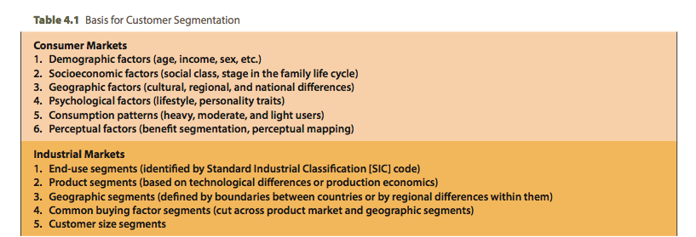
Market Segmentation (cont’d)

Slide 9

What: Determining Which
Customer Needs to Satisfy
Customer needs are related to a product’s benefits and features.
Customer needs are neither right nor wrong, good nor bad.
Customer needs represent desires in terms of features and performance capabilities.

Slide 10
How: Determining Core Competencies Necessary to Satisfy Customer Needs
Firms must decide:
  who to serve, what customer needs to meet, and how to use core competencies to implement value creating strategies that satisfy target customers’ needs.
Only firms with capacity to continuously improve, innovate and upgrade their competencies can expect to meet and/or exceed customer expectations across time.

Slide 11
The Purpose of a
Business-Level Strategy
Business-Level Strategies:
  are intended to create differences between the firm’s competitive position and those of its competitors.
To position itself, the firm must decide whether it intends to:
  perform activities differently or
  perform different activities as compared to its rivals.

Slide 12
Types of Potential
Competitive Advantage
Achieving lower overall costs than rivals
  Performing activities differently (reducing process costs)
Possessing the capability to differentiate the firm’s product or service and command a premium price
  Performing different (more highly valued) activities.

Slide 13

Competitive Scope
Broad Scope
  The firm competes in many customer segments.
Narrow Scope
  The firm selects a segment or group of segments in the industry and tailors its strategy to serving them at the exclusion of others.

Slide 14
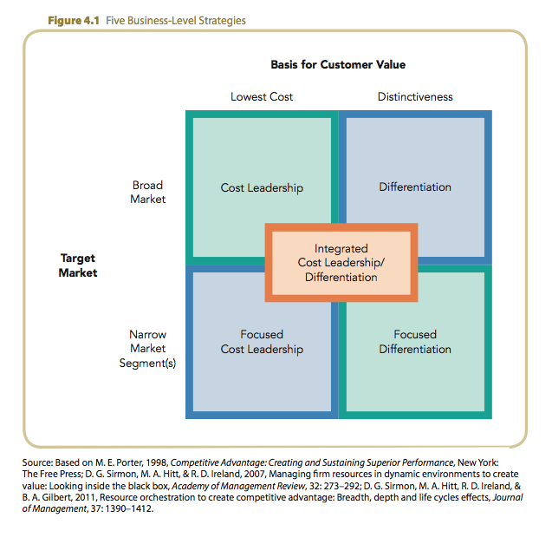
Business Level Strategies

Slide 15
Cost Leadership Strategy
An integrated set of actions taken to produce goods or services with features that are acceptable to customers at the lowest cost, relative to that of competitors.
Product Characteristics
  Relatively standardized (commoditized) products
  Features broadly acceptable to many customers
  Lowest competitive price

Slide 16
Cost Leadership Strategy
Cost saving actions required by this strategy
  Building efficient scale facilities
  Tightly controlling production costs and overhead
  Minimizing costs of sales, R&D and service
  Building efficient manufacturing facilities
  Monitoring costs of activities provided by outsiders
  Simplifying production processes

Slide 17

How to Obtain a Cost Advantage
Determine
and control
Cost Drivers
Reconfigure Value Chain if needed
Alter production process
New raw material
Change in automation
Forward integration
New distribution channel
Backward integration
New advertising media
Change location relative to suppliers or buyers
Direct sales in place of indirect sales

Slide 18
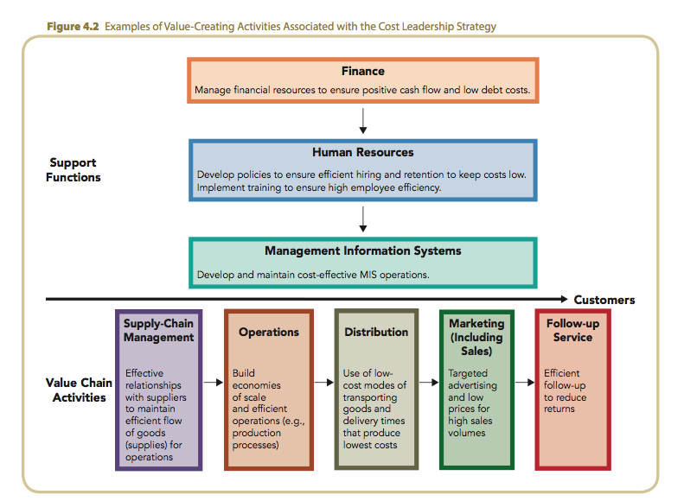
Value-Creating Activities for Cost Leadership

Slide 19
Value-Creating Activities for Cost Leadership
Monitor suppliers’ performances
Link suppliers’ products to production processes
Economies of scale
Efficient-scale facilities
Effective delivery schedules
Low-cost transportation
Highly trained sales force
Proper pricing
Cost-effective MIS
Few management layers
Simplified planning
Consistent policies
Effecting training
Easy-to-use manufacturing
technologies
Investments in technologies
Finding low-cost raw
materials

Slide 20
Cost Leadership Strategy: Competitors
Due to cost leader’s advantageous position:
  rivals hesitate to compete on basis of price.
  lack of price competition leads to greater profits.
Rivalry with Existing Competitors
Threat of new entrants
Rivalry
among competing firms
Bargaining power of suppliers
Threat of substitute products
Bargaining power of buyers

Slide 21
Cost Leadership Strategy: Buyers
Can mitigate buyers’ power by:
  driving prices far below competitors, causing them to exit, thus shifting power with buyers (customers) back to the firm.
Bargaining Power
of Buyers
Threat of new entrants
Rivalry
among competing firms
Bargaining power of suppliers
Threat of substitute products
Bargaining power of buyers

Slide 22
Cost Leadership Strategy: Suppliers
Can mitigate suppliers’ power by:
  being able to absorb cost increases due to low cost position.
  being able to make
  very large purchases, reducing chance of supplier using power.
Bargaining Power
of Suppliers
Threat of new entrants
Rivalry
among competing firms
Bargaining power of suppliers
Threat of substitute products
Bargaining power of buyers

Slide 23
Cost Leadership Strategy: New Entrants
The Threat of
Potential Entrants
Can frighten off new entrants due to:
  their need to enter on a large scale in order to be cost competitive.
  the time it takes to move down the industry learning curve.
Threat of new entrants
Rivalry
among competing firms
Bargaining power of suppliers
Threat of substitute products
Bargaining power of buyers

Slide 24
Cost Leadership Strategy: Substitutes
Product
Substitutes
Cost leader is well positioned to:
  lower prices in order to maintain its value position.
  make investments to add features unavailable in substitutes.
  buy intellectual property and patents developed by potential substitutes.
Threat of new entrants
Rivalry
among competing firms
Bargaining power of suppliers
Threat of substitute products
Bargaining power of buyers

Slide 25
Cost Leadership Strategy (cont’d)
Competitive Risks
  Processes used to produce and distribute good or service may become obsolete due to competitors’ innovations.
  Too much focus on cost reductions may occur at expense of customers’ perceptions of differentiation.
  Competitors, using their own core competencies, may successfully imitate the cost leader’s strategy.

Slide 26
Differentiation Strategy
An integrated set of actions taken to produce goods or services (at an acceptable cost) that customers perceive as being different in ways that are important to them.
  Focus is on non-standardized products
  Appropriate when customers value differentiated features more than they value low cost

Slide 27
How to Obtain a
Differentiation Advantage
Control
Cost Drivers if needed
Reconfigure Value Chain to maximize
Lower buyers’ costs
Raise performance of product or service
Create sustainability through:
customer perceptions of uniqueness
customer reluctance to switch to non-unique product or service

Slide 28
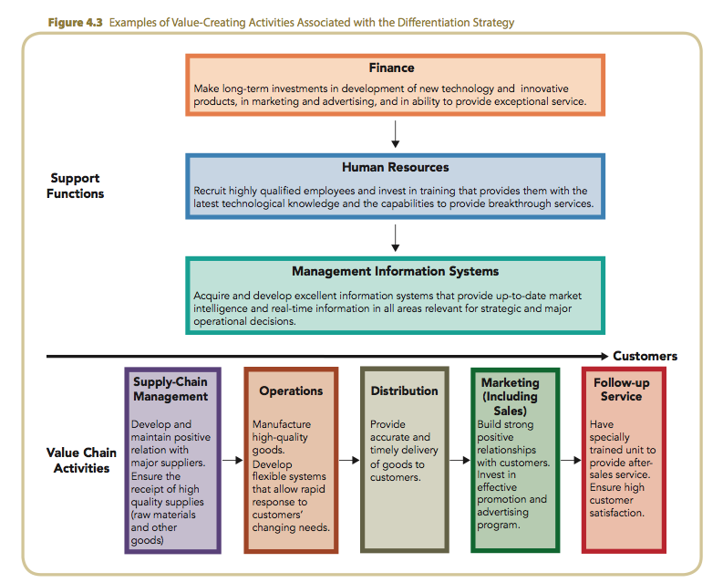
Value-Creating Activities and Differentiation

Slide 29
Value-Creating Activities and Differentiation
Highly developed MIS
Emphasis on quality
Worker compensation for creativity/productivity
Use of subjective performance measures
Basic research capability
Technology
High quality raw materials
Delivery of products
High quality replacement parts
Superior handling of incoming raw materials
Attractive products
Rapid response to customer specifications
Order-processing procedures
Customer credit
Personal relationships

Slide 30
Differentiation Strategy: Competitors
Rivalry with
Existing Competitors
Defends against competitors because customer’s brand loyalty to differentiated product offsets price competition.
Threat of new entrants
Rivalry
among competing firms
Bargaining power of suppliers
Threat of substitute products
Bargaining power of buyers

Slide 31
Differentiation Strategy: Buyers
Bargaining Power
of Buyers
Can mitigate buyers’ power because well differentiated products reduce customer sensitivity to price increases.
Threat of new entrants
Rivalry
among competing firms
Bargaining power of suppliers
Threat of substitute products
Bargaining power of buyers

Slide 32
Differentiation Strategy: Suppliers
Bargaining Power
of Suppliers
Can mitigate suppliers’ power by:
  absorbing price increases due to higher margins.
  passing along higher supplier prices because buyers are loyal to a differentiated brand.
Threat of new entrants
Rivalry
among competing firms
Bargaining power of suppliers
Threat of substitute products
Bargaining power of buyers

Slide 33
Differentiation Strategy: New Entrants
The Threat of
Potential Entrants
Can defend against new entrants because:
  new products must surpass proven products.
  new products must be at least equal to performance of proven products, but offered at lower prices.
Threat of new entrants
Rivalry
among competing firms
Bargaining power of suppliers
Threat of substitute products
Bargaining power of buyers

Slide 34
Differentiation Strategy: Substitutes
Product
Substitutes
Well-positioned relative to substitutes because:
  brand loyalty to a differentiated product tends to reduce customers’ testing of new products or switching brands.
Threat of new entrants
Rivalry
among competing firms
Bargaining power of suppliers
Threat of substitute products
Bargaining power of buyers

Slide 35
Competitive Risks of Differentiation
The price differential between the differentiator’s product and the cost leader’s product becomes too large.
Differentiation ceases to provide value for which customers are willing to pay.
Experience narrows customers’ perceptions of the value of differentiated features.
Counterfeit goods replicate the differentiated features of the firm’s products.

Slide 36
Focus Strategies
An integrated set of actions taken to produce goods or services that serve the needs of a particular competitive segment.
  Particular buyer group—youths or senior citizens
  Different segment of a product line—professional craftsmen versus do-it-yourselfers
  Different geographic markets—east coast versus west coast

Slide 37
Focus Strategies (cont’d)
Types of focused strategies
  Focused cost leadership strategy
  Focused differentiation strategy
To implement a focus strategy, firms must be able to:
  complete various primary and support activities in a competitively superior manner, in order to develop and sustain a competitive advantage and earn above-average returns.

Slide 38
Factors That Drive Focused Strategies
Large firms may overlook small niches.
A firm may lack the resources needed to compete in the broader market.
A firm is able to serve a narrow market segment more effectively than can its larger industry-wide competitors.
Focusing allows the firm to direct its resources to certain value chain activities to build competitive advantage.

Slide 39
Competitive Risks of Focus Strategies
A focusing firm may be “out focused” by its competitors.
A large competitor may set its sights on a firm’s niche market.
Customer preferences in a niche market may change to more closely resemble those of the broader market.

Slide 40
Integrated Cost Leadership/
Differentiation Strategy
A firm that successfully uses an integrated cost leadership/differentiation strategy should be in a better position to:
  adapt quickly to environmental changes.
  learn new skills and technologies more quickly.
  effectively leverage its core competencies while competing against its rivals.

Slide 41
Integrated Cost Leadership/
Differentiation Strategy (cont’d)
Commitment to strategic flexibility is necessary for implementation of integrated cost leadership/ differentiation strategy.
  Flexible manufacturing systems (FMS)
  Information networks (CRM)
  Total quality management (TQM) systems

Slide 42
Risks of an Integrated Cost Leadership/ Differentiation Strategy
Often involves compromises
  Becoming neither the lowest cost nor the most differentiated firm
Becoming “stuck in the middle”
  Lacking the strong commitment and expertise that accompanies firms following either a cost leadership or a differentiated strategy

